Slide 1
Safety Moments
from CDM Smith’s health and safety experts

Slide 2

Safety Training
Only do work that you are trained for
Ask for the training you need
Work with the project manager or safety supervisor to identify safety training you may need
Notes:
The concept of “safety first” applies to everything we do—no matter what. If you work in the field or in an office, it’s vital that you employ safe behaviors and practices at all times.
Proper training is necessary to help you identify risk and avoid potential injuries, accidents and issues.
Before you do any work or perform any task, ask yourself if you have received the appropriate training and if it is current. If you have not or your certifications have lapsed, ask for the training you need. Seek out safety courses offered by your employer or 3rd party.
Remember: Always think ahead about training, and only do work you are trained to perform.

Slide 3
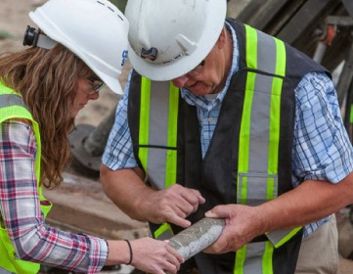
Personal Protection Equipment (PPE)
Wear PPE to safeguard against injuries and illness
Equip yourself and convey that you’re ready to work safely and responsibly
Check H&S manuals and talk to the onsite supervisor to see what’s required
Inspect PPE prior to use
Notes:
Wearing personal protective equipment (PPE) makes injury and illness less likely to happen. Before you go to any job site, identify potential hazards to help determine the level of protective gear you’ll need. Remember to inspect your PPE regularly prior to use to ensure it’s in working order.
Another benefit to wearing PPE is upholding your organization’s reputation. When you’re properly equipped, you convey that you are ready to work in a responsible, safe manner.
Organizations regulate the use of PPE for different situations. Many require wearing it during all field tasks. Check your company’s Health and Safety manual to see what’s required. Typical PPE may include:
Hardhat
Safety glasses with side shield
Steel toe and shank footwear
Full-length pants
Shirt with sleeves and collar
Whenever you are working outside of an office environment, put this equipment on! Hazardous conditions also often require:
Protective gloves (if hands will contact rough or contaminated surfaces)
High-visibility vest (if vehicles or heavy equipment operate on site)

Slide 4
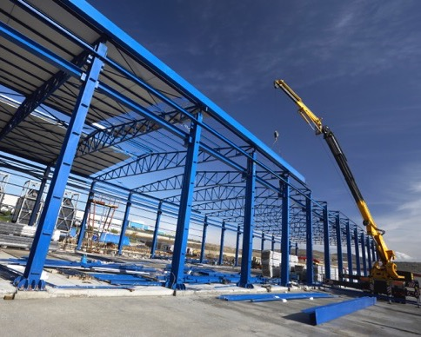
Hazard Identification
Keep work area neat to
reduce likelihood of hazards
Review potential hazards before tasks begin
Correct identified hazards immediately
Notes:
Keep your work area and jobsite neat. Poor housekeeping not only creates hazards but can hide more serious hazards.
Look for things that can fall or tip over. Make sure materials and supplies are safely stored and appropriately restrained.
Correct identified hazards immediately – don’t leave them for someone else!
Use fencing, barricades, and signage to warn others of hazards that cannot be corrected immediately.
Focus on the task at hand. Distractions often allow small hazards to become big injuries!
Take a moment before beginning a task to review the hazards. Ask:
What could go wrong?
Is there a safer way to perform this task?
Do I have the correct tools for the job?
Do I need assistance? Better to be a safe, healthy team player than an injured superhero!
Look for changes in your work area – construction is full of changes that introduce new hazards.

Slide 5
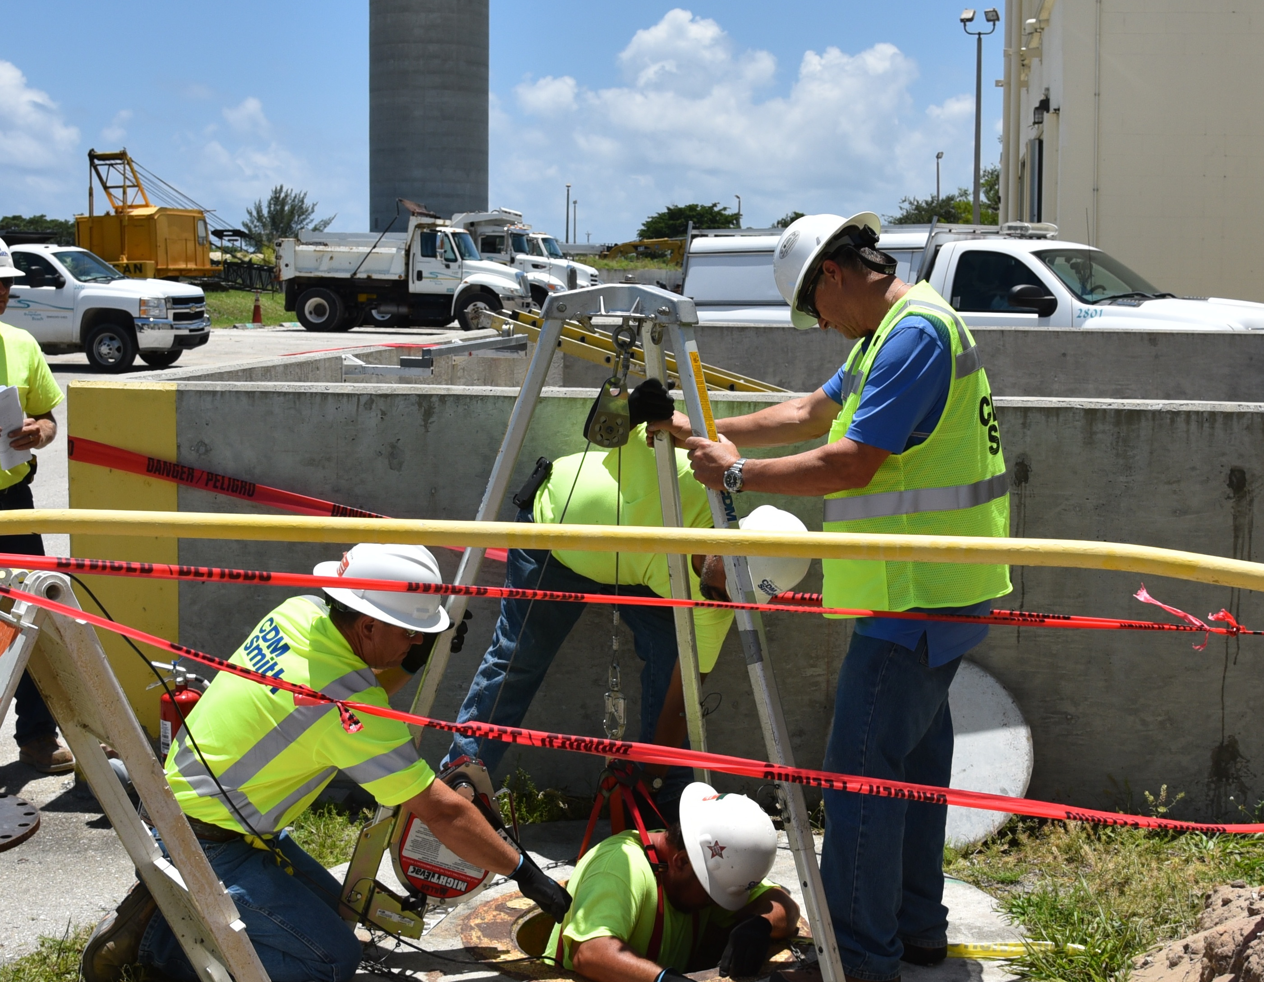
Confined Space Entry
Do you have an exit plan?
Understand and follow procedures to get out safely in emergencies
Have you identified any potential permit- or non-permit required confined spaces?
Remember that you must be trained to enter a confined space
Notes:
What’s your exit plan?
Conditions in confined spaces are uncomfortable and generally more dangerous. Whenever you must enter one, identify all the potential hazards you might encounter:
Limited entry and exit
Restricted movement
Physical barriers
Oxygen-deficiency
Lack of natural ventilation
Flammable/explosive atmospheres
Once potential hazards are identified, understand and follow the procedures to get you out in emergency situations. Know the following: how to reach emergency rescue personnel, where first-aid is located, if there is a nursing station on site, where extraction equipment is located and how to access it. Strong communication and adherence to these protocols by all team members will keep everyone safe and healthy.
Remember: You must be trained to enter and work in a confined space!

Slide 6
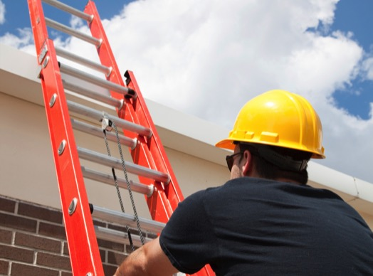
Ladder Safety
There are 30,000 ladder-related
injuries each year
Don’t take shortcuts—follow all the rules for using ladders properly
Notes:
Slips and falls are the leading cause of deaths in and around the home, killing more than 6,000 people a year. Many more people are disabled in similar mishaps. A major subset of these mishaps involves ladders, which are involved in more than 30,000 injuries per year. Although ladders appear simple, there are rules to follow when using them.
Use the right kind of ladder for your task, and make sure it complies with specifications of the American National Standards Institute and that it is listed by Underwriters Laboratories. Most homeowners need a stepladder and a straight ladder (usually an extension ladder).
Read and follow the manufacturer's instructions on the label attached to the ladder.
Make sure your ladder is tall (or long) enough. For stepladders, obey the "not a step" markings on the top steps and the shelf.
Check over your ladder before you trust it. Look for damaged rungs, steps, hinges and braces. If damaged, repair it or replace it. Antiques are nice, but not when it comes to ladders.
Make sure you can lock the spreaders on stepladders in place.
Extension ladders should have "safety feet" that stabilize the ladder and keep it from slipping.
Set your ladder on a solid surface and keep it level.
Open stepladders fully.
When using a straight ladder, the base should be 1 foot away from the vertical surface for every 4 feet of height (to the point when the top of the ladder will rest).
If you're climbing onto your roof or a platform, make sure the ladder extends above the edge by at least 3 feet.
Never lean a ladder against an unstable surface, such as a tree limb.
Always face the ladder when climbing. Carry tools in a tool belt that you can raise and lower with a rope from the ladder. Tool belts are recommended over buckets due to overloading and (sometimes) poor craftsmanship.
Make sure your shoes aren't slippery.
You can put non-skid on the rungs of an aluminum ladder.
Hold on with one hand while working on a ladder. Don't reach too far to the sides or behind you.
Don't climb higher than the second step from the top on a stepladder or the third from the top on a straight ladder.
Only one person should be on the ladder at a time.
Tables, boxes and chairs aren't ladders.
Don't put ladders on barrels, boxes, concrete blocks or other unstable bases.

Slide 7
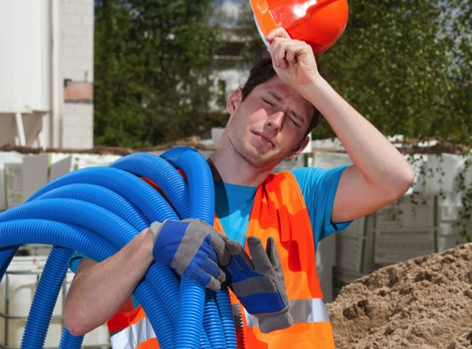
Guarding Against Heat Stress
Monitor weather forecast and plan for high temps
Extreme heat can require acclimation and monitoring
Stay hydrated
Wear sunscreen
Perform heavy labor during early morning and evening if possible
Notes:
When the heat is on, take the following precautionary steps:
Alert workers to the temperatures and heat index for the day, inform them of the precautions to prevent heat-related illnesses.
Regularly monitor weather forecast, plan for high temperatures.
Perform heavy labor during the early morning hours or evening if possible.
Provide adequate cool drinking water close to work site.
Ensure adequate medical services are available.
Acclimatize workers performing strenuous work – workers not used to the work may be at high risk for heat-related illnesses, even if the heat index is low.
Take additional precautions for workers wearing heavy or non-breathable clothing – these workers can experience heat-related illness in temperatures as low as 70°F.
Encourage outdoor workers to wear sunscreen and use additional protection (hats, cooling apparel, safety glasses with dark lenses, etc.).

Slide 8

Lightning
Lightning causes 25-30 deaths
per year in the U.S.
Find safe shelters: substantial building or enclosed metal vehicle
If you’re outside, get low to the ground but DO NOT lie down!
Wait until thunder/lightning passes before resuming activities
Notes:
In the U.S., there are about 25 million lightning flashes every year.
There are 25-30 lightning-related deaths annually. In 2014, there were 26 lightning-related deaths, according to the National Weather Service.
When lightning strikes, find safe shelters: A substantial building or an enclosed metal vehicle.
Stay away from open windows, sinks, toilets, tubs, showers, electric boxes and outlets, and appliances. Avoid using regular telephones.
If caught outside, get as low as possible without touching your hands or knees to the ground. DO NOT LIE DOWN!

Slide 9
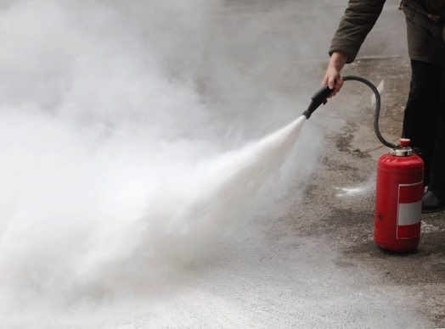
Fire Protection
Pick up trash and combustible materials
Control ignition sources
Require fire watches after hot work activities
Keep fire extinguishers within grasp and know how to use
Notes:
While the danger of a fire is very real and significant, some simple steps can and should be taken to minimize the potential for a fire:
Ensuring that you receive training on the use of fire extinguishers.
Maintaining good housekeeping practices—making sure trash and combustible materials picked up and fuel sources are minimized.
Controlling ignition sources is another important component of fire prevention – Hot Work Permits ensure safety when working with the potential ignition sources (torch cutting, grinding metal, etc.).
Requiring fire watches for 30 minutes following completion of hot work activities.
Keeping fire extinguishers in the immediate area of hot work and staged near fuel storage areas.

Slide 10

Crane Safety
125,000 cranes in operation today in the construction industry
100,000 additional cranes in marine and general use
71 fatalities each year
Notes:
Crane incidents pop up in the news on a regular basis—not surprising when you think about the dangers cranes present for their operators. By nature of the extremely heavy loads cranes lift, operators are outmatched if something goes wrong. Loads are also difficult to rig and can experience unexpected movements that may cause incidents to occur.
The main way to avoid crane injuries and (in the worst cases) fatalities is to stay clear of the load and keep your focus on the mobilization and demobilization of the cranes.
Other tips:
Consider needed crane movements prior to set up and make every effort to avoid moving the load over the job site.
Maintain awareness of what is happening around you and above you.
If you see a load coming, get out of the way and look out for others. It’s possible that an operator may not have considered the dangers of moving a load over your area.
Riggers may have to work near a suspended load to guide it into position. Use of tag lines can help keep you out of harm’s way; it will put distance between yourself and the load in the event that it shift or moves unexpectedly. Remember: your weight is no match for a load that is swinging or spinning and gaining momentum. Let it settle itself.
Never loop tag lines around your hard, arm or body. This could cause you to be dragged along with the load. Wear protective gloves to avoid rope burn.
If you are guiding a load with a tag line, check that your travel path is clear and safe before the load is suspended.

Slide 11
Safe-Think Process

Slide 12

Safe-Think Process
Before starting a new task, ask yourself:
  What am I going to do?
  How could I or someone else get hurt?
  Do I have the right equipment?
  Do I need help?

Slide 13

Safe-Think Process
When working at a desk, assess the situation by asking yourself:
  Are my desk, chair and workstation set up properly?
  Am I comfortable?
  Do I take sufficient breaks to allow for appropriate rest periods?

Slide 14

Safe-Think Process
Before carrying and/or lifting something:
  Is my travel path clear and trip/slip free?
  Is it too heavy or hard to hold onto?
  Am I wearing the right footwear to safely lift and object?
  Do I need help from others or tools, such as dollies?

